Slide 1
Lecture 2
D&D Chapter 2 & Intro to Eclipse IDE

Slide 2
Eclipse
Eclipse IDE
Primitive variables
Getting input
Arithmetic
Flow control with if-else
Eclipse Debugger
Eclipse is an Integrated Development Environment (IDE).
IDEs have lots of support to make programming easier
Auto-complete and hints
Real time compiling
Project management
Debugging support
A zillion other things and they are extensible
There are lots of different IDEs, and lots of Java ones. Some are designed for a particular type of development (e.g. cross-platform apps). Some are proprietary (e.g. Visual Studio is Microsoft’s IDE for all their programming languages)
IDEs are big and complex, but definitely worth the investment for the support they provide.

Slide 3
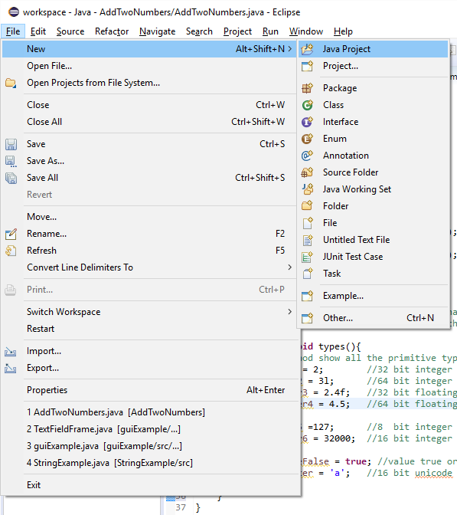
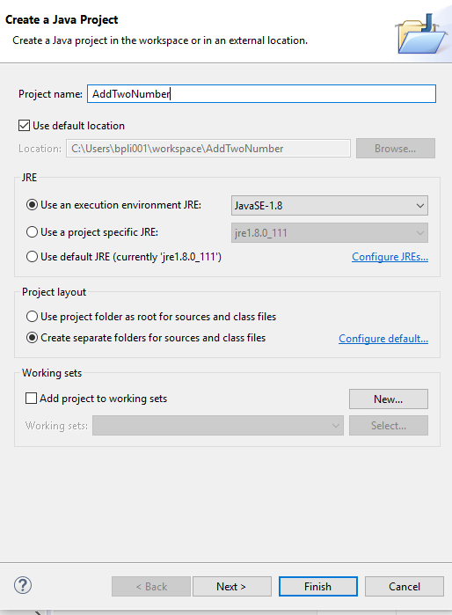
Eclipse basics
Eclipse IDE
Primitive variables
Getting input
Arithmetic
Flow control with if-else
Eclipse Debugger
All programs must be in their own project
1
2
3

Slide 4
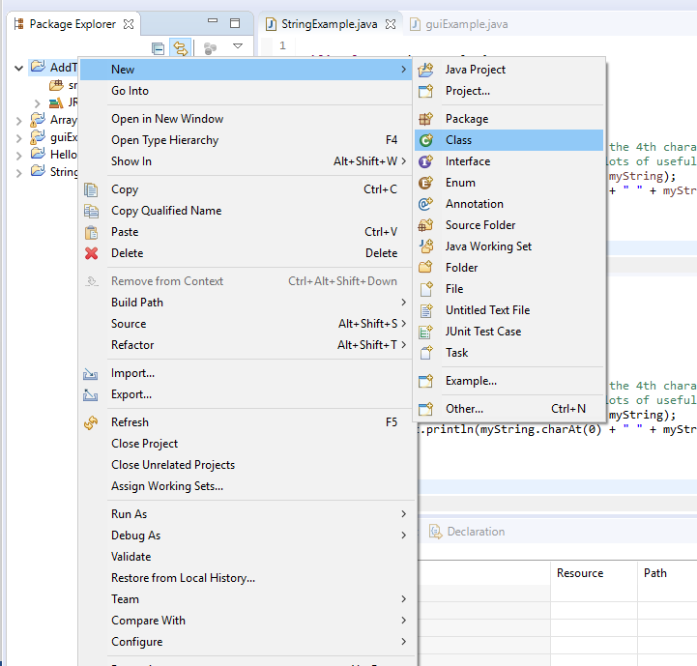
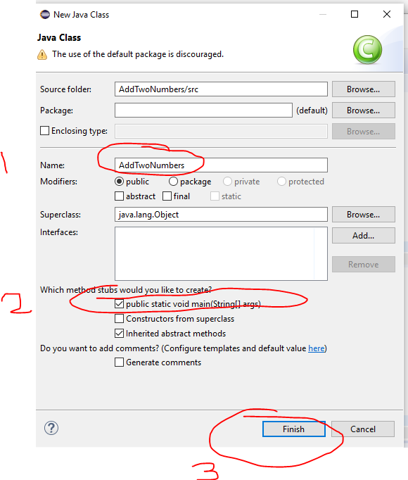
Add a class
Eclipse IDE
Primitive variables
Getting input
Arithmetic
Flow control with if-else
Eclipse Debugger

Slide 5
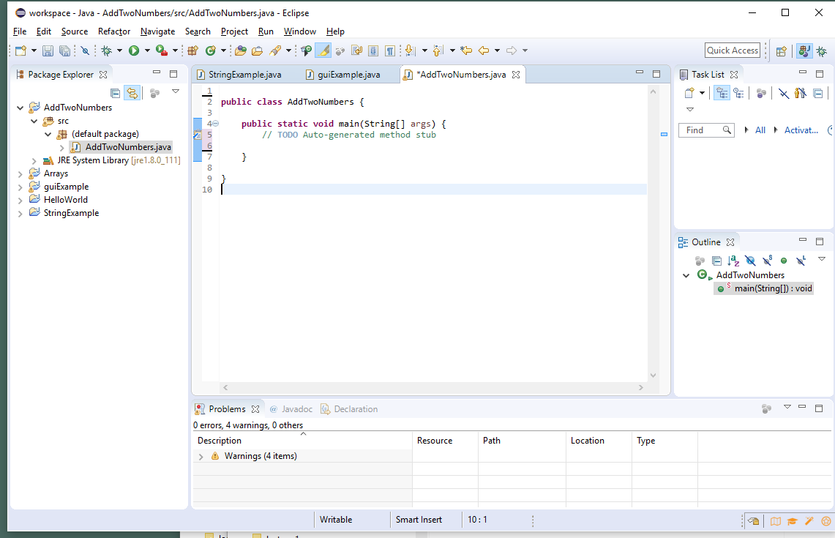
Empty Class
Eclipse IDE
Primitive variables
Getting input
Arithmetic
Flow control with if-else
Eclipse Debugger

Slide 6
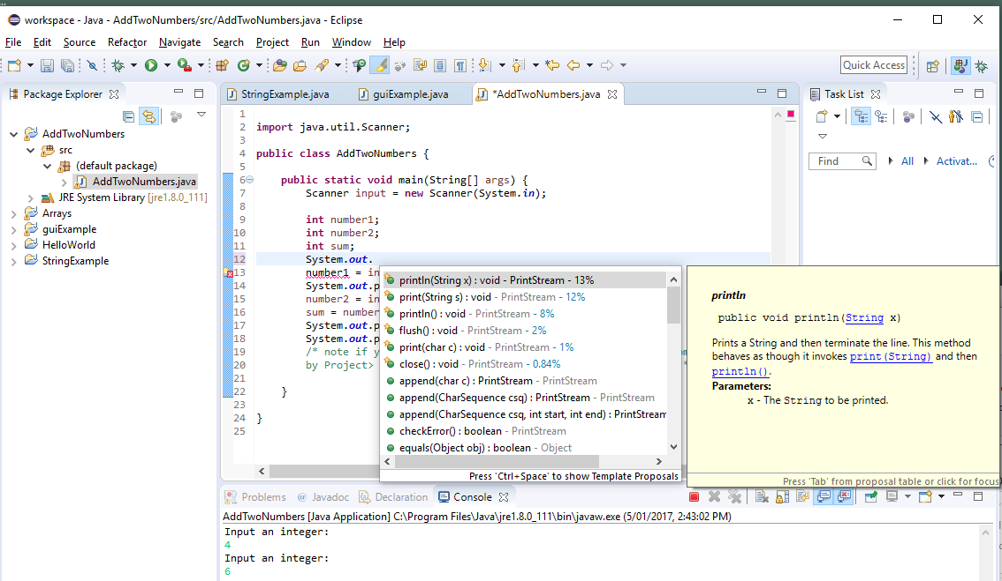
The payback
Eclipse IDE
Primitive variables
Getting input
Arithmetic
Flow control with if-else
Eclipse Debugger
Intelligent support when you push . e.g., System.
Real time syntax checking and hints
Debugging support (we will do that later)

Slide 7
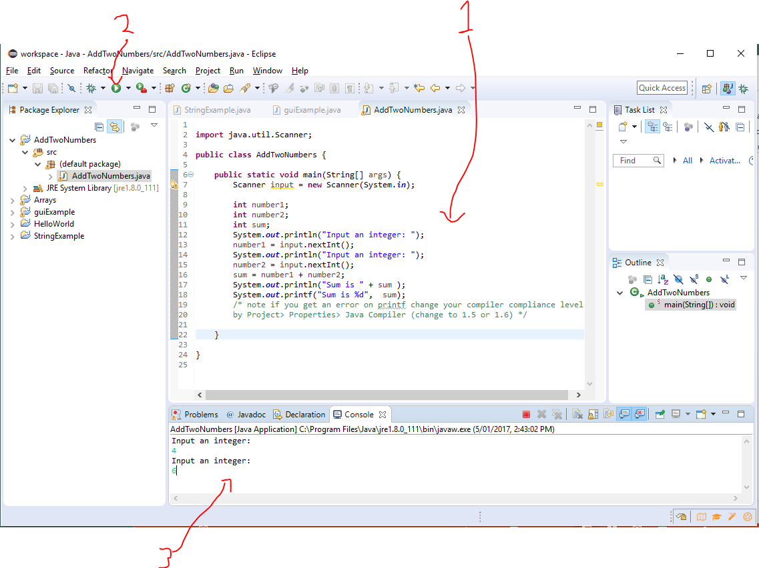
Run your program
Eclipse IDE
Primitive variables
Getting input
Arithmetic
Flow control with if-else
Eclipse Debugger

Slide 8
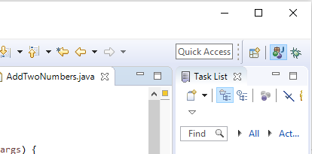
Note: Fixing the views
Eclipse IDE
Primitive variables
Getting input
Arithmetic
Flow control with if-else
Eclipse Debugger
Eclipse has lots of windows and they float, open close etc.
Really easy to mess it up!
You want the Java Perspective (Window/Perspective/Open Perspective/Java Browsing)
Reset perspective
Right click and choose reset

Slide 9
Simple console output
Eclipse IDE
Variables –primitives
Getting input
Arithmetic
Flow control with if-else
Eclipse Debugger
Before we start looking at variables, a few words about output:
// System.out.println() outputs its argument
System.out.println(); // prints just a newline
System.out.println(42); // prints 42 and a newline
System.out.print(42); // prints just 42
System.out.print("Hello!") // prints Hello
System.out.print(42 + 8); // prints 50
System.out.print("Formula " + 1); // prints Formula 1 System.out.print("Hello " + "World"); // prints Hello World
// System.out.printf() got ported from C. It uses a string
// with format codes (such as %d or %.1f) to output data just // the way the programmer wants. Examples follow!

Slide 10
Variables
import java.util.Scanner;
public class AddTwoNumbers {
public static void main(String[] args) {
Scanner input = new Scanner(System.in);
int number1;
int number2;
int sum;
System.out.println("Input an integer: ");
number1 = input.nextInt();
System.out.println("Input an integer: ");
number2 = input.nextInt();
sum = number1 + number2;
System.out.println("Sum is " + sum );
System.out.printf("Sum is %d", sum);
/* note if you get an error on printf change your compiler compliance level by Project> Properties> Java Compiler (to 1.5 or 1.6) */
}
}
Eclipse IDE
Variables –primitives
Getting input
Arithmetic
Flow control with if-else
Eclipse Debugger
Note the printf() here – output an int (sum) with %d

Slide 11
Declaring Variables
Eclipse IDE
Variables –primitives
Getting input
Arithmetic
Flow control with if-else
Eclipse Debugger
………
int number1;
int number2;
int sum;
……..
All variables must be declared before they are used.
Java variables are statically typed – i.e. you cannot change a variable’s type during the execution of the program (“runtime”).
Variables can be declared pretty much anywhere inside a class.
Where they are declared sets their scope
Scope is the current block, i.e., inside the { } in which the variable is declared. The variable is not visible outside this block.
Note: public class and object variables are visible outside the block in which they are declared, but need to be accessed via the class or via their object (we’ll come to that later)

Slide 12
Primitive types
Eclipse IDE
Variables –primitives
Getting input
Arithmetic
Flow control with if-else
Eclipse Debugger
// most common numeric types
int number1 = 2; //32 bit integer
long number2 = 3l; //64 bit integer
float number3 = 2.4f; //32 bit floating point double number4 = 4.5; //64 bit floating point
// smaller integer (not used much)
byte number5 =127; //8 bit integer
short number6 = 32000; //16 bit integer
// others
boolean trueFalse = true; //value true or false
char character = 'a'; //16 bit unicode character
There are 8 primitive types
See the literals for each above
We will come to String later (it is not a primitive)

Slide 13
Getting input
Import the Scanner class from the java.util.Scanner package. Packages are bits of existing code (often provided with Java) that provide us with functionality we need. In this case, we need a Scanner object that lets us read input from the keyboard. The package provides us with the Scanner class we need to construct the object.
Eclipse IDE
Variables –primitives
Getting input
Arithmetic
Flow control with if-else
Eclipse Debugger
import java.util.Scanner;
……
Scanner input = new Scanner(System.in);
…….
System.out.println("Input an integer: ");
number1 = input.nextInt();
System.out.println("Input an integer: ");
number2 = input.nextInt();
Create (“instantiate”) a new Scanner object from the Scanner class (which acts like a blueprint). For this, we use the keyword new. We store (a reference to) the new Scanner object in the variable input, which is of type Scanner. Note: Every class defines a type, and variables of a class type can store references to objects of that class.
Here, we invoke the nextInt() method on our Scanner object to give us the next integer value that the user inputs on the keyboard. We store that integer value in the integer variable number1

Slide 14
Arithmetic
Eclipse IDE
Variables –primitives
Getting input
Arithmetic
Flow control with if-else
Eclipse Debugger
………
sum = number1 + number2;
……..
Arithmetic operators and precedence
First () Brackets
Second * multiply
/ divide
% remainder
Third + add
- subtract
Finally = assignment
More operators in the next lecture
Worth knowing: A lot of the most frequent operators in Java are the same as in python!

Slide 15
Arithmetic (integer)
Eclipse IDE
Variables –primitives
Getting input
Arithmetic
Flow control with if-else
Eclipse Debugger
Exercise: What are the answers?
total = 3+ 5 * 2;
total = (3+ 5) * 2;
total = 3 * 5 + 2;
total = 5 % 3 + 4;
Make up some more
If you can’t find the answer by thinking about it, don’t ask. Instead, try with your own piece of code!

Slide 16
if statements
Eclipse IDE
Variables –primitives
Getting input
Arithmetic
Flow control with if-else
Eclipse Debugger
import java.util.Scanner;
public class Ifs {
public static void main(String[] args) {
Scanner input = new Scanner(System.in);
int number1;
int number2;
int sum;
System.out.println("Input an integer: ");
number1 = input.nextInt();
System.out.println("Input an integer: ");
number2 = input.nextInt();
if (number1 == number2)
System.out.println("They are the same");
else if (number1 < number2)
System.out.println("The first number is smaller");
else
System.out.println("The first number is bigger");
}
}

Slide 17
Relational Operators
Eclipse IDE
Variables –primitives
Getting input
Arithmetic
Flow control with if-else
Eclipse Debugger
…..
if (number1 == number2)
System.out.println("They are the same");
else if (number1 < number2)
System.out.println("The first number is smaller");
else
System.out.println("The first number is bigger");
…….
Relational operators
== equal (don’t get caught out and put a single =)
< less than
> Greater than
<= less than or equal
>= greater than or equal

Slide 18
Common error
Eclipse IDE
Variables –primitives
Getting input
Arithmetic
Flow control with if-else
Eclipse Debugger
if (number1 == number2);
System.out.println("They are the same");
This ; terminates the if-statement
The println() will always be executed.

Slide 19
if-else with blocks
Eclipse IDE
Variables –primitives
Getting input
Arithmetic
Flow control with if-else
Eclipse Debugger
if (number1 == number2) {
System.out.println("The numbers are the same");
}
else
{
System.out.println("The numbers are different");
}

Slide 20
Caution trap!
Eclipse IDE
Variables –primitives
Getting input
Arithmetic
Flow control with if-else
Eclipse Debugger
if (number1 == number2) {
System.out.println("The numbers are the same");
int numberToUse = number1;
}
else
{
System.out.println("The numbers are different");
int numberToUse = 0;
}
System.out.println("Using number " + numberToUse);
This probably won’t compile. Why?

Slide 21
Bugs
Eclipse IDE
Variables –primitives
Getting input
Arithmetic
Flow control with if-else
Eclipse Debugger
In Java, you can have three types of problem:
Your classes don’t compile.
This is always the result of a syntax error or the failure to import the right package(s)
Usually, javac will tell you what is wrong
Sometimes, your mistake may not be in the line that javac points out. Examples: The previous statement does not end with a semicolon, you forgot to declare a variable, didn’t close a parenthesis, or you are trying to access a variable out of scope.
Your classes compile, but your program crashes with an exception.
Your classes compile and your program doesn’t crash, but it doesn’t do what you expect it to do.
In the last two cases, using a debugger can help.

Slide 22
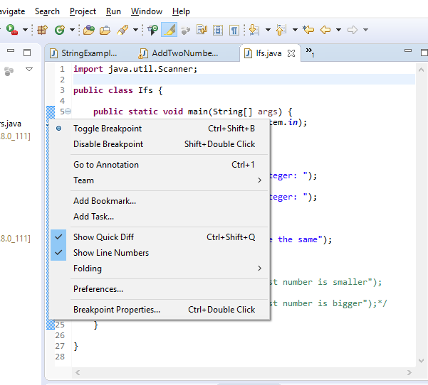

Using the Debugger
Eclipse IDE
Variables –primitives
Getting input
Arithmetic
Flow control with if-else
Eclipse Debugger
Set a break point on the first line of your code (right click in the blue margin beside the line)
Start the debugger (F5)

Slide 23
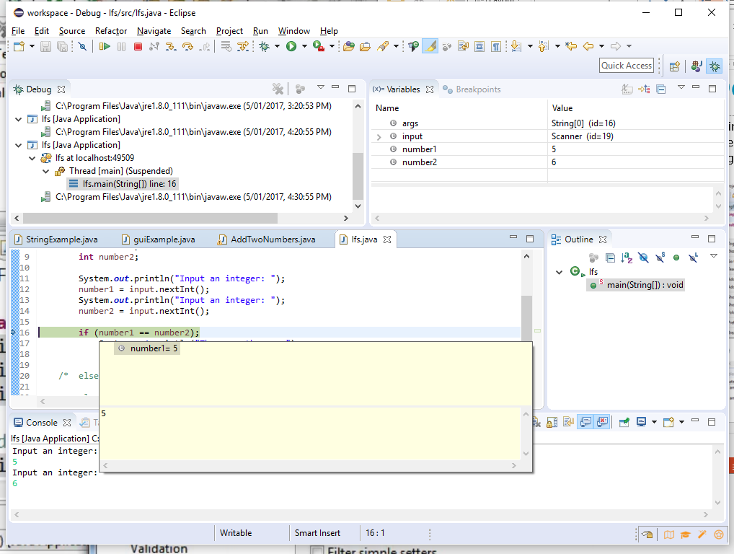
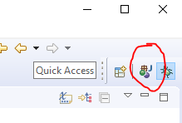
Debug perspective
Eclipse IDE
Variables –primitives
Getting input
Arithmetic
Flow control with if-else
Eclipse Debugger
Step through line by line (F5)
Check variable values by cursor over
Change back to Java perspective

Slide 24
What do we know
Eclipse IDE
Variables –primitives
Getting input
Arithmetic
Flow control with if-else
Eclipse Debugger
Eclipse (and other IDEs) take a little effort to learn but it’s worth it
Variables
All variables must be declared before they are used
Variables are statically typed at the time you declare them and are only visible inside the {} of declaration
There are 8 primitive data types (and String isn’t one of them) the main ones are int, double and boolean
You can get input from the console with the java.util.Scanner class
Arithmetic
Java has the standard operators and orders of precedence (more operators next lecture)
Flow control with if-else statements
Java has the standard operators
Be very careful not to put a ; at the end of your if(x==y) because that will terminate the if
Debugger will let you step through your code and inspect the values in the variables.

Slide 25
Resources & Homework
Eclipse IDE
Variables –primitives
Getting input
Arithmetic
Flow control with if-else
Eclipse Debugger
D&D chapter 2 - read it.
Oracle https://docs.oracle.com/javase/tutorial/java/nutsandbolts/variables.html
Eclipse IDE quick start tutorial https://www.youtube.com/watch?v=23tAK5zdQ9c
Debugging tutorial (don’t worry about understanding the code yet) https://www.youtube.com/watch?v=Jyc2brswNQo
Homework
Get Java and Eclipse working on your machine.
Write and run HelloWorld
Do the Chapter 2 self review questions

Slide 26
Next Lecture
D&D Chapters 3 & 4
if statements
Loops
More operators

